Slide 1
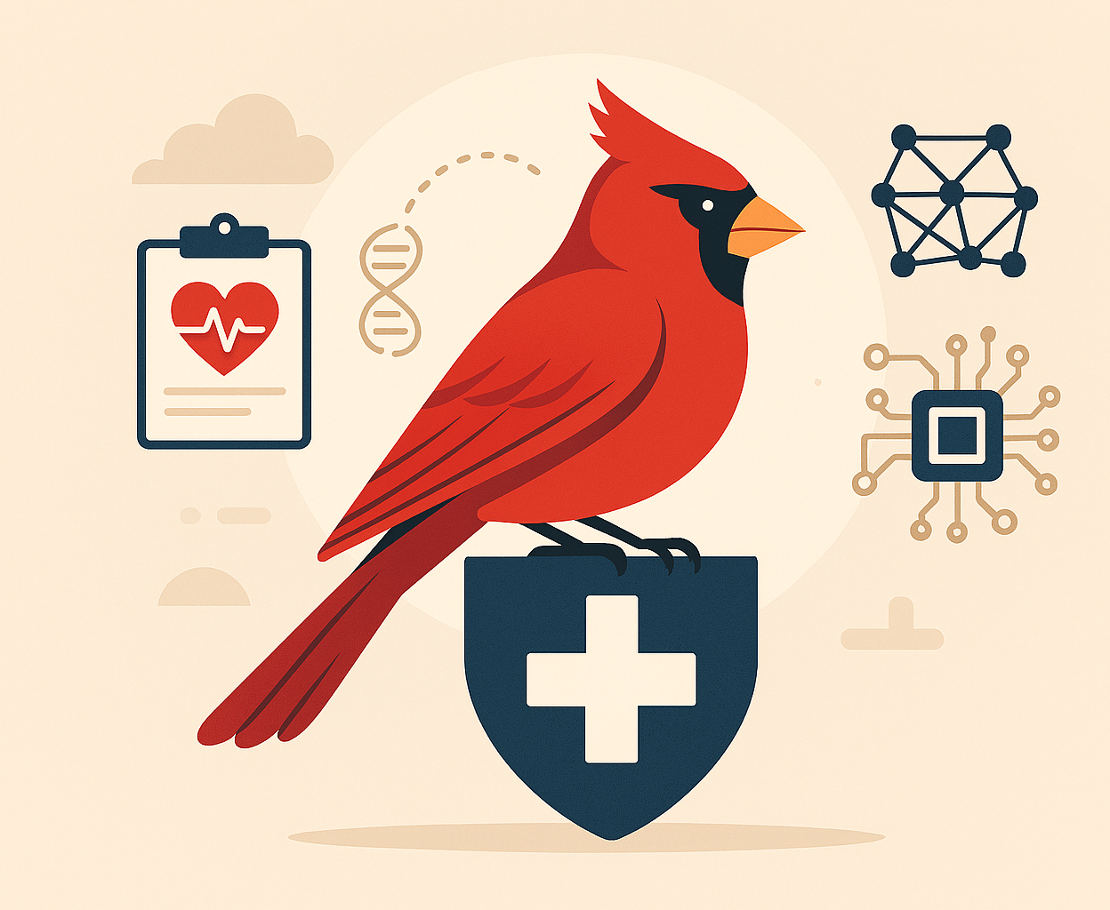
Cardinal AI
By Michael Friedman and Jason Godfrey

Slide 2

Product & Purpose
Product:
Modern HRA using better data and machine learning
Focus on recent data, personalization, explainability
Efficient modeling improves healthcare decision-making
Cardinal name reflects importance and Cyclone pride
Purpose:
Healthcare tech must evolve with changing human needs
Current HRAs are outdated and underutilized
Depend on infrequent self-reported surveys
Assume identical risks across diverse demographics

Slide 3
Data Strategy
Data acquisition:
Current health data collection is infrequent and outdated
Annual questionnaires are not enough for accurate risks
Cardinal AI uses frequent surveys, sensors, and smartphones
Wearables measure activity, heart signals, and other biomarkers
Better data leads to better health insights and outcomes
Data modeling:
Goal: predict early health risks and key drivers
Use classification or regression based on outcome type
Examples: fall-risk classification, weight-trajectory regression
Models updated continuously as new data arrives
Evaluate performance with AUC and Brier Score

Slide 4
Ethics & Market
Key ethical concerns:
Sensitive health data requires strong privacy and consent
Biased data can lead to unfair assessments
Transparency builds user and clinician trust
Ethical design protects patient well-being
Target market
Uses continuous wearable data, not yearly surveys
Improves accuracy and personalization of risk assessments
Combines multiple data sources for clearer insights
Helps organizations modernize preventive care and adapt to trends

Slide 5
Data Analysis
The models
Logistic Regression — interpretable clinical risk predictions
XGBoost — top performance on tabular health data
GAMs — explainable nonlinear health relationships
Why these models?
Prioritize transparency for clinicians and users
Support continuous updates with new data
Handle mixed wearable and survey inputs
Ensure fairness across demographic groups
Enable clear explanations via SHAP values
Optimize for fast deployment and efficiency

Slide 6

Product Highlights
Real-Time Data Collection
Cardinal AI uses advanced techniques to collect real-time health data for accurate and relevant risk assessments.
Personalized Assessments
Health risk assessments are tailored to individual profiles, improving accuracy and avoiding generalized assumptions.
Explainable AI Insights
The system ensures healthcare providers and patients understand the reasoning behind risk predictions clearly.
Efficient and Scalable Modeling
Efficient modeling techniques deliver rapid, accurate insights scalable across diverse healthcare environments.
Notes:
Cardinal AI is designed to transform the way health risk assessments (HRAs) are conducted by leveraging advanced data acquisition and machine learning techniques. Unlike traditional HRAs that rely on outdated, infrequently self-reported data, Cardinal AI prioritizes real-time data collection and adaptive modeling to ensure accuracy and relevance. The product emphasizes personalization, meaning that assessments are tailored to individual health profiles rather than applying generalized assumptions across demographics. Explainability is another cornerstone of Cardinal AI, ensuring that healthcare providers and patients can understand the reasoning behind risk predictions. Efficient modeling techniques are employed to deliver rapid insights without compromising accuracy, making the system scalable for diverse healthcare environments. By integrating these features, Cardinal AI aims to provide actionable health insights that empower both patients and providers to make informed decisions, ultimately improving health outcomes and reducing systemic inefficiencies in the healthcare industry.

Slide 7
Why Cardinal AI?
Limitations of Current HRAs
Traditional health risk assessments rely on infrequent self-reported data and overlook dynamic health changes.
Need for Personalization
Uniform risk models ignore differences in age, ethnicity, and lifestyle affecting individual health risks.
Cardinal AI’s Approach
Uses continuous data streams and adaptive algorithms to provide timely and accurate risk assessments.
Empowering Healthcare
Personalization and explainability help providers deliver precise care and enable patient understanding.
Notes:
The purpose of Cardinal AI is rooted in addressing critical shortcomings of current health risk assessment practices. Modern HRAs are often outdated and fail to meet the dynamic needs of evolving human health. Two major issues stand out: first, they depend heavily on infrequent self-reported data, typically collected through annual questionnaires, which cannot capture ongoing changes in health status. Second, they assume uniform relationships across different demographic groups, ignoring the unique health patterns and risk factors that vary by age, ethnicity, and lifestyle. Cardinal AI solves these problems by using continuous data streams and adaptive algorithms that adjust to individual and population-level variations. This approach ensures that risk assessments are not only timely but also contextually accurate. By prioritizing personalization and explainability, Cardinal AI empowers healthcare providers to deliver more precise interventions and enables patients to understand their health risks clearly. The ultimate goal is to create a system that evolves alongside human health, ensuring relevance and effectiveness in a rapidly changing healthcare landscape.

Slide 8
